Slide 1
TRAFFIC MANAGEMENT - PHASE 3
NAME : C.DHANUSHKUMAR
COLLEGE CODE : 7139
NM ID : au713921106010
EMAIL ID : dkdhanushkumar003@gmail.com

Slide 2
PROJECT TITTLE TRAFFIC MANAGEMENT
PHASE 3:DEVELOPMENT PART 1
Traffic management is the organisation, arrangement, guidance and control of both stationary and moving traffic, including pedestrians, bicyclists and all types of vehicles. Its aim is to provide for the safe, orderly and efficient movement of persons and goods, and to protect and, where possible, enhance the quality of the local environment on and adjacent to traffic facilities
AI&ADS
Traffic flow prediction - AI models can be designed to run analysis on historical and real-time traffic data. This is done in order to consolidate the data and use it to understand patterns and trends in traffic flow. Predictive analysis is used by traffic planners to forecast future conditions so that personnel are better able to deal with it effAI&ADS
ectively in terms of resource allocation, route optimization to minimize traffic congestion, and the adjustment of traffic signal times.
Incident detection and management - AI-powered systems can be used to identify and detect traffic incidents such as accidents, wrong-way driver detection, overspeeding, or road blockages. Once detected, this information can be used to immediately dispatch personnel to the site and ensure a speedy response. It can also be used to hasten supplementary actions such as rerouting traffic from the area.
Adaptive traffic signal control - Traditional traffic signal systems are programmed to operate on fixed schedules, proving inefficient in unanticipated scenarios and causing inefficient traffic flow. Adaptive traffic signals are deployed to align with shifts in demand. These signals can identify peak demand conditions and adjust their timings accordingly. This helps in optimizing traffic flow and reduces congestion by placing priority on high-traffic roads.
The video below shows how intelligent video analysis can be used together with regular security cameras to obtain real time information about traffic flow and

Slide 3
Advertising traffic managers supervise a company's marketing efforts from beginning to end. First they work with departments to set marketing budgets. Once they have a budget they may come up with a advertising campaign; assessing marketing research, the effectiveness of websites and various adverting options.
DAC:
IBM Cognos Analytics is a powerful business intelligence and data analytics platform that can help you gain deep insights into your website's performance and audience behavior. It enables you to collect, analyze, and visualize data from various sources, allowing you to make informed decisions and optimize your website traffic strategies.
With its user-friendly interface and robust features, IBM Cognos Analytics empowers marketers and business owners to extract meaningful insights from their data and drive actionable improvements. Whether you're a small business owner or part of a large enterprise, IBM Cognos Analytics can be a valuable tool in your arsenal for boosting website traffic.

Slide 4
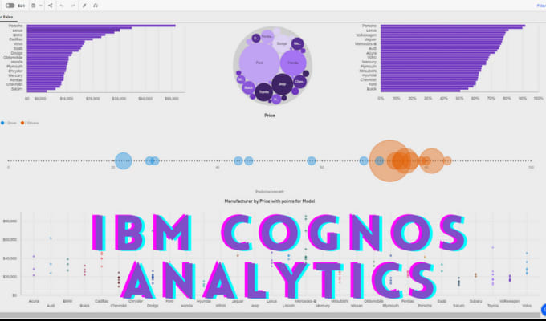

Slide 5
An Internet of Things (IoT)-enabled intelligent traffic management system can solve pertinent issues by leveraging technologies like wireless connectivity & intelligent sensors. Considered a cornerstone of a smart city, they help improve the comfort and safety of drivers, passengers & pedestrians.
1. Smart traffic signals
2. Emergency assistance via IoT technology
3. Optimized commutes with apps such as Waze
4. Smart parking technology
5. Safer truck driving and fleet management
6. Predictive vehicle maintenance
7. Enhanced tolls and ticketing

Slide 6
Traffic Lights and IoT Control Systems: Smart traffic signals may look like a typical stoplight, yet they utilize an array of sensors to monitor real-time traffic. Usually, the goal is to help cars reduce the amount of time spent idle. And IoT technology enables the various signals to communicate with each other. This is while adapting to changing traffic conditions in real time. The outcome is less time spent in traffic jams and even reduced carbon emissions.
Parking Enabled through IoT: Smart meters and mobile apps make on-street parking spaces easily accessible with instant notifications. Drivers receive alerts whenever a parking spot is available to reserve it instantly. The app gives easy directions to the parking spot with a convenient online payment option.
Emergency Assistance through IoT: A traffic monitoring system using IoT technology enables emergency responders to speed up the care mechanism in case of accidents late at night or in isolated locations. The sensors on the road detect any accident, and the problem is immediately reported to the traffic management system. This request is passed on to relevant authorities to take corrective action. Emergency response personnel would include medical technicians, police officers, and fire departments for enhanced responsiveness and timely intervention.
Commute Assistance: With every vehicle acting as an IoT sensor, a dedicated app can make suggestions, determine optimal routes & provide advance notice of accidents or traffic jams. Further, it can even suggest the best time to leave. It is all because of a robust algorithm that helps reduce driving time with intelligent traffic lights.

Slide 7
CAD:
As a Temporary Traffic Management Designer, you will use an array of the latest software available in the industry, to the highest level from 2D street works to 3D BIM designs on high speed dual carriageways.
You will be responsible for designing these projects in line with regulations and reporting to our Design supervisor. Other duties will include:
Traffic Management CAD designing
Attending client meetings
Maintenance of internal design records
Conducting design risk assessments

Slide 8
IBM Cloud compute type, look at your applications in your IBM® Cloud Foundry hosting environment.
For most cloud hosted applications, internal application code makes up most of the effort for that application. Where it is hosted, how it is connected, how traffic flows, services connections, and so on is a thin layer on top of or connected to the application. As you migrate your applications, only the thin layer should need to be addressed. Most of your application will function the same on any hosting compute service.
There are a few things you need to determine and decide before you migrate your set of applications to a new IBM Cloud location. You might already know most of the details about your IBM® Cloud Foundry application deployments, especially if your organization planned the deployment and set up the hosting environment for the applications.
For those users wanting to confirm their application hosting layout, or investigate what they currently have deployed to IBM® Cloud Foundry, there are several methods to analyze their current deployment.

Slide 9
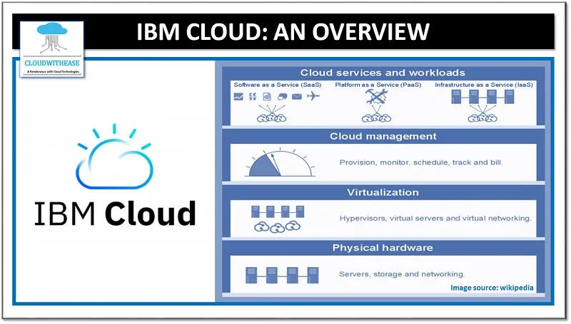

Slide 10
Access control - Fine grain assignment/dispensing of compute capacity to development teams.
Automatic placement - Apps are automatically placed across multiple data-center PODs for maximum reliability.
Automatic health management - Crashing apps restart automatically.
Automatic routing - Internet reachable routes are automatically created for your apps.
High availability - Supports full high availability for high app availability.
Automatic deployment scaling - The Auto-Scaling for IBM Cloud service automatically increases or decreases the compute capacity of your app, to rapidly adjust to dynamic loading needs.

